Slide 1

HANDS-ON WITH REACT
useEffect() hook

Slide 2
The useEffect() hook
Sometimes, a React component needs to interact with the “outside world”, performing actions that are not directly related to the UI output of a component. For example:
Making a request to an external API
Interacting with browser APIs (e.g., writing to local storage)
These actions are called “side effects”. The useEffect hook allows us to manage side effects without interfering with the rendering of the component.
Before we see a practical example, let’s cover the different ways in which useEffect works.

Slide 3
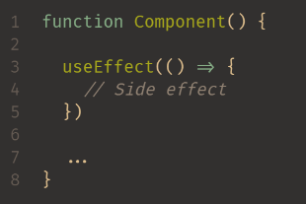
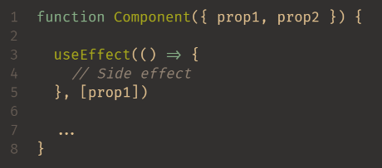
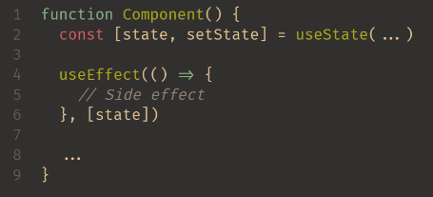
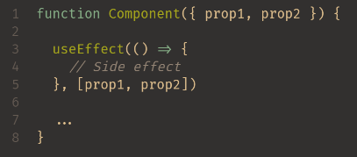
How useEffect works (1/2)
Takes in a function containing your side effect code
Second argument is the “dependency array”
This will run the side effect after every render (the first time the component displays, and every time it updates)
This will run the side effect after the first render and after any time the value of prop1 changes
Multiple dependencies
This will run after the first render and after any time any of the dependencies change (as long as the dependency is a prop or state value)
This will run after the first render and after any time the state value changes
Notes:
Notes for example 1
Explain that useEffect is placed at the top level of your component
Running an effect after every render is not something you’d see particularly often.
Notes for example 2
The code inside a useEffect will always run the first time a component is rendered.
Whenever the component re-renders, React will check if any of the items inside the dependency array have changed, and if so, the code inside the useEffect will run again.

Slide 4
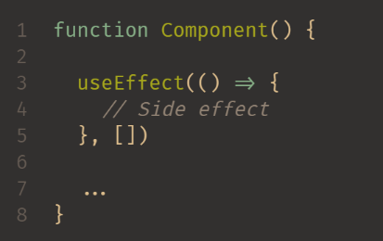
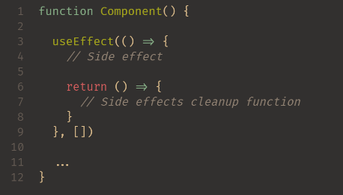
How useEffect works (2/2)
Empty array – what will happen?
This will run after first render only (when the component mounts)
If you need to clean up any side effects, return a function that handles the cleanup
Notes:
Notes for example 1 (Empty dependency array example)
Used to perform actions when the component mounts, including any set-up you might need to do
Notes for example 2 (final example)
It’s really important to clean up your side effects. For example, if you start a timer when a component mounts, then you need to dispose of that timer when the component unmounts. Otherwise, the timer will stay active and present in memory, causing memory leaks

Slide 5
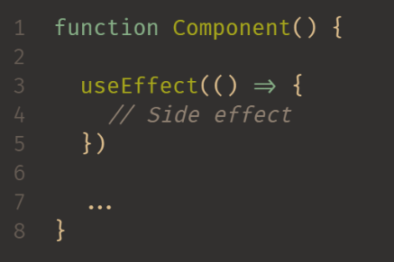
Pitfall: forgetting the dependency array
Remember, with no dependency array, this will run on every render. If you are doing anything that uses up a quota or costs money (e.g., reads from a database), having no dependency array is likely a mistake which will have consequences if your component re-renders often.
Even worse, if you modify state within this effect, then the state change will trigger a re-render, which will trigger the effect, which will trigger a re-render, which will trigger the effect… An infinite loop. This will also affect the performance of your app.

Slide 6
The useEffect hook
Now that we’ve looked at how useEffect works, let’s see it in practice.
Remember, useEffect needs to be imported like useState and by default, runs when the page first renders.
We change when we want the code to run but adding dependencies in the useEffect call
We will use State set as Boolean true or false to log something to the console each time another state is changed

Slide 7


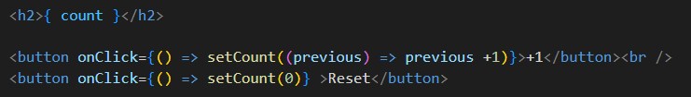
The useEffect hook
He we have 2 States, one number, the other Boolean.
A button exists to toggle logging
The count is then displayed, along with a button to increment and another to reset

Slide 8
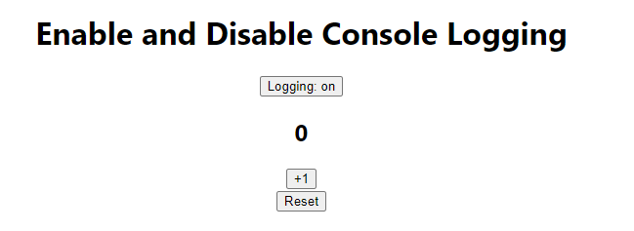
The useEffect hook
The result is this simple page

Slide 9
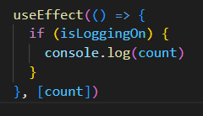
The useEffect hook
Lets add a useEffect to control when the logging happens.
Each time the count State changes, this useEffect runs. It checks to see if logging is true or false.
If true, it logs the value of count to the console.

Slide 10
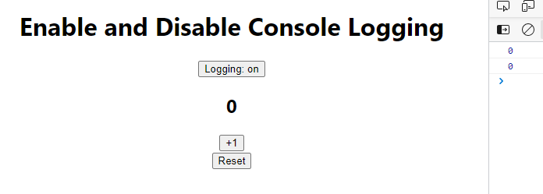
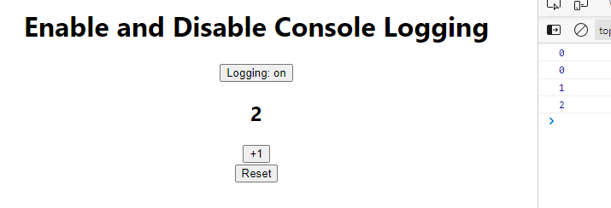
The useEffect hook
Notes:
Here, it logs when the page renders and the count is set. It logs when the count is changed

Slide 11
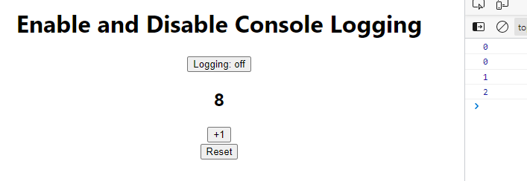
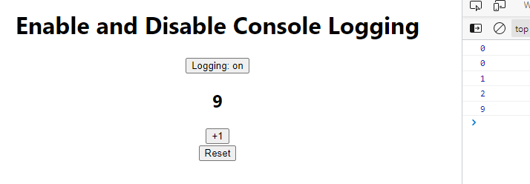
The useEffect hook
Notes:
When logging is turned off, the count changes but is not logged to the console. When the logging is turned back on, it continues at the later number

Slide 12
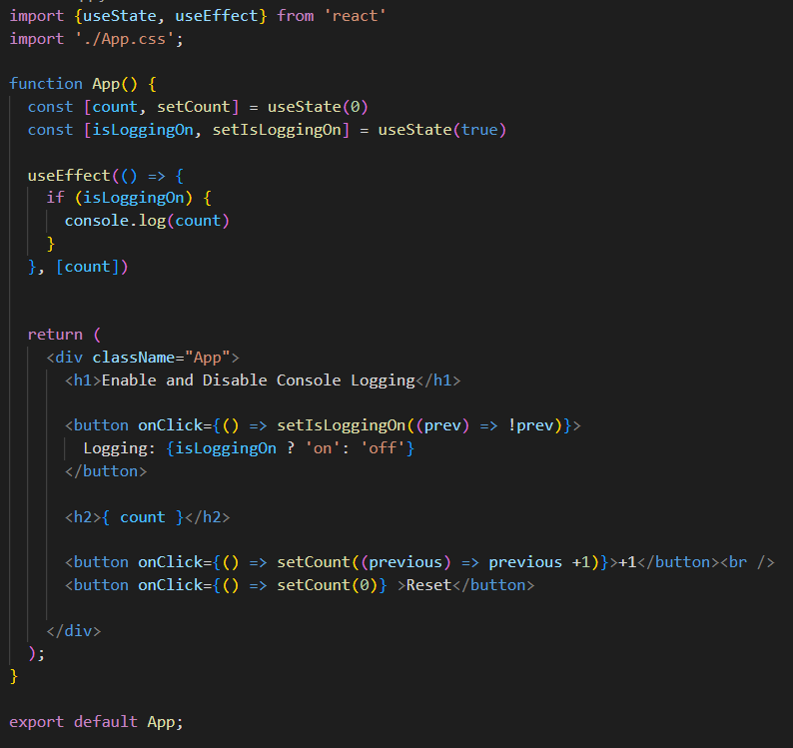
The useEffect hook
Notes:
Discuss the final code

Slide 13
QuickLab 10
useEffect

